Slide 1
Trends in Legislative-Executive Relations
The situational context of policy making is crucial to understanding fluctuations in legislative–executive relations
Two sets of factors: Nature of issues and timing of decisions
Congress more active in economic issues, issues tied to domestic issues (such as immigration)
President given more leeway at beginning of term (“honeymoon period”), Congress more likely to be active later
Presidents also given more freedom during crises
Congressional diplomacy plays critical role as well
Notes:
Learning Objective: 5.1
Can we think of a reason for why Congress tends to be more engaged when it comes to economic issues, or even immigration?

Slide 2
Collaboration and Discord in the Cold War
Post–World War II threat of Soviet Union: Truman’s containment doctrine
Congressional consensus in containing communism
National Security Act of 1947
Bretton Woods institutions
NATO
Limited troop deployments (South Korea)
Eisenhower’s expansion of military alliances, nuclear arsenal also supported by Congress
Congressional foreign policy role: “legitimizing of presidential decisions”
Benefits for congressional members in form of military contracts, new military bases, interstate highway system
Notes:
Learning Objective: 5.1

Slide 3
Collaboration and Discord in the Cold War
Domestic consensus continued under Kennedy
Johnson: Gulf of Tonkin Resolution (1964) gave carte blanche support for intervention in Vietnam
Nixon: Congress divided from president, mostly Democrats
Vietnam War unpopular, Watergate scandal
Structural reforms in Congress to promote oversight in foreign and domestic affairs
Less of a seniority system
More committees and subcommittees
Notes:
Learning Objective: 5.1

Slide 4
Collaboration and Discord in the Cold War
String of oversight legislation in foreign affairs in the 1970s
Case–Zablocki Act: Required president to report all international agreements to Congress within 60 days of the agreement’s entering into force
War Powers Resolution: Required president to report all military deployments to Congress and authorized Congress to order the troops home after 60 days
Nelson–Bingham Amendment: Required congressional review of arms sales of more than $25 million
Jackson–Vanik Amendment: Prevented granting most-favored nation trade status to countries that restrict emigration
Intelligence Oversight Act: Allowed House and Senate committees to oversee U.S. intelligence activities and required president to notify Congress of covert operations
Notes:
Learning Objective: 5.1

Slide 5
New Tensions in the New World Order
New global environment after end of the Cold War
George H. W. Bush’s “New World Order” causes more animosity with Congress
Intensified polarization of Congress
Generational shifts, different experiences of legislators
New Democrats abandoned Clinton; Republican majority elected in Congress (new isolationism)
Sen. Jesse Helms campaigned against international affairs budgets, agencies, ambassadors
Rejected Comprehensive Test Ban Treaty, which was popular worldwide; rejection of Kyoto protocol, ICC.
Notes:
Learning Objective: 5.1

Slide 6
Deference in the War on Terror
George W. Bush: Entered office with united government, no major foreign policy agenda
Terrorist attacks ended discord between executive and legislative branches for first years of war on terror
Authorization for the Use of Military Force of 2001 (AUMF) in Afghanistan
USA PATRIOT Act
Authorization for war in Iraq
Notes:
Learning Objective: 5.1

Slide 7
Congressional Pushback in the Obama Years
Dissent about intelligence gathering and military occupation in Iraq
2006 elections: Democrats regain majority status in both chambers
2008 presidential election: Brief period of united government
2010 elections: Republicans regain control of the House
Leads to more divided government and political gridlock
Reelection of President Obama
More pushback regarding foreign policy goals as members of Congress complain that president is “too passive” on important issues and challenges
Russia’s annexation of Ukraine
Iran’s nuclear ambitions
Lack of intervention in Syria
Notes:
Learning Objective: 5.1

Slide 8
Deference and Opposition in the Age of Trump
2016, Trump’s “America First” platform supported by some rejected by others.
Attracts support from House republicans
Some Senate republicans are more critical of President’s foreign policy orientation.
2018 Midterms
Democrats take back the House, Republicans expand lead in the Senate.
More pushback regarding Trump’s foreign policy goals as members of Congress reject administration’s border wall and emergency declaration.
Others critical of troop withdrawal in the Middle East
President’s remarks regarding authoritarian leaders around the world

Slide 9
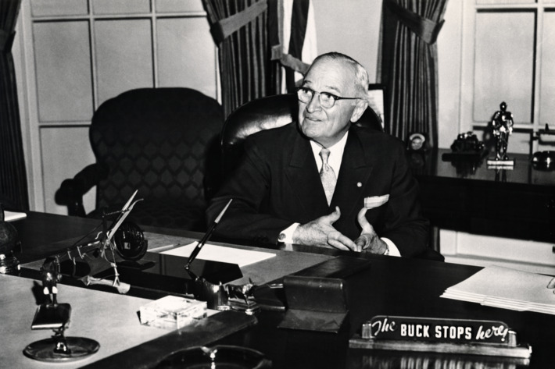
Constraints on Congressional Action
Several factors deprive Congress of bigger role in U.S. foreign policy
Passing the buck
Structural weaknesses
Judicial noninterference
Constituent service
Notes:
Learning Objective: 5.2

Slide 10
Legislating Foreign Policy
Congress faces institutional and structural limitations on activism and coherent foreign policy making
Large membership allows for collective-action problems
Political parties inside Congress, often divided, lead to partisan battles
No one voice as powerful as the president’s
Judicial branch tends to side with president or not to rule on foreign affairs
Electoral concerns and perpetual campaigning frequently hamper representatives
Focus on domestic politics and constituent services or constant “guns-or-butter” debate in which butter wins
Notes:
Learning Objective: 5.3

Slide 11
The Calculus of Voting Behavior
What motivates congressional behavior (voting, agenda setting, relationships with executive branch)?
Situational factors: Evaluating costs and benefits of each decision
Ideological factors: Worldviews of politics
Electoral factors: Constantly seeking reelection and appealing to “supportive constituents”
Strategic factors: Compromises and negotiations inside Congress
Logrolling: Deals to support legislation in exchange for future support of legislation
Notes:
Learning Objective: 5.3

Slide 12
Dynamics of the Legislative Process
Foreign policy entrepreneurs within Congress try to affect the foreign policy agenda
Creation of new federal agencies without Congress is impossible
Department of Homeland Security, joint effort with President Bush
Reforms of existing agencies, such as forcing the State Department to absorb the U.S. Information Agency and the U.S. Arms Control Disarmament Agency
Limits on executive branch and agencies, such as reporting requirements
Increased and mandated participation in the foreign policy process, such as the Trade Act of 1974
Notes:
Learning Objective: 5.3

Slide 13
Foreign Policy by Committee
Party majority in government allows committee designation and control
Decisions and agenda setting done mostly in committee
Committees also perform oversight functions
Senate Foreign Relations Committee and House Foreign Affairs Committee
Issues rarely tied to constituent needs
Senate and House Armed Services Committee
Attract legislators because of large financial stakes
Select Intelligence Committees, Appropriations
Notes:
Learning Objective: 5.3

Slide 14
War Powers and the Use of Force
Congress has the power to declare war and to fund military and defense operations, but the president is the commander of the armed forces
Constant conflict over war powers
In this area, lawmakers have three sets of concerns:
Whether or not to approve military action
If action is ordered, what steps Congress could play to support the use of force
How well the missions have been planned and executed
Notes:
Learning Objective: 5.4

Slide 15
The War Powers Act
War Powers Resolution of 1973: Congressional leaders fearful of imperial presidency
President must consult with Congress over possible armed conflict
Notification requirement when troops are deployed
President must periodically report status of military incidents
Presidents have dismissed the resolution as unconstitutional but continue to submit WPR reports to Congress
Seven military conflicts since Cold War involving president’s legal authority
Three authorized by Congress (AUMF)
Four used UN obligations to justify
Wars of necessity vs. wars of choice
Notes:
Learning Objective: 5.4
Specifications of the WPA?
Notification can be issue 48 after the initial intervention.
Congress has 60 days to vote on the constitutionality of this move, approving troop deployment.
Can extend this another 30 days, creating a 90 day, 3-month window of operation.
How do we distinguish between wars of necessity and wars of choice?

Slide 16
The Oversight of Torture
Controversy over Bush administration’s detention policies, CIA “black sites,” coercive interrogations, policy of extraordinary rendition
Senate conducted detailed study of CIA’s actions using oversight power, with these findings:
The CIA interrogation program was mismanaged and not subject to adequate oversight.
Interrogators in the field who tried to stop the brutal techniques were repeatedly overruled by senior CIA officials.
The CIA misled members of Congress and the White House about the effectiveness and extent of its brutal interrogation techniques.
The CIA leaked classified information to journalists, exaggerating the success of the interrogation methods in an effort to gain public support.
Notes:
Learning Objective: 5.4

Slide 17
The Power of the Purse
Congressional power to collect taxes and oversee discretionary spending
Provides checks and balances; hedge against excessive presidential ambition
Allows a deliberative body to manage finances
Congressional committees hold keys to spending on defense, international affairs, and foreign assistance
Negotiations between executive agencies, congressional committees, and White House
Notes:
Learning Objective: 5.5

Slide 18
Managing the Defense Budget
Largest share of spending to national defense, increased after 9/11
Guns-or-butter debates: Military vs. domestic spending debates
Disagreements between president and Congress over spending, each with own budget plans and offices
Problems with iron triangles and overpriced military expenditures
Pork-barrel politics: Representatives secure military and other projects for their home districts
Conflict since end of Cold War over supply and weaponry companies/plants
2009 appropriations bill passed under Obama administration noted U.S. forces should be prepared for unconventional wars of the future rather than superpower showdowns of the Cold War
Notes:
Learning Objective: 5.5

Slide 19
The Price of Diplomacy
International affairs budget: Includes State Department and foreign aid, but less than 2% of federal budget in 2009
Diplomacy not as valued as defense in political culture and history
Debates on the value of diplomacy
Since 9/11, more interest in Congress in the soft power of nonmilitary international programs, such as aid, training, and overseas diplomacy
Continuation of enhancing soft power tools under Obama
Goal of rebuilding trust internationally
Notes:
Learning Objective: 5.5

Slide 20
Conclusion
Fragmentation and diffusion of government power, of which legislative–executive relations is but one element, ensure the erratic exercise of world power by the United States.
War strengthens the executive branch and rewards congressional deference.
However, mutual legislative–executive accommodation is best for an orderly foreign policy process.

